Slide 1
Astronomy/Reach for the Stars 2020
JHU Competitors and Coaches Clinic
Anand Gnanadesikan

Slide 2
Basic rules for study events
Read the rules
Build a binder
For each concept in the list of concepts, write down a paragraph or so of information/include pictures.
Your students may, or may not be allowed to use the binder in the test… but the process of building it will give them a huge amount of information.
Do not simply download and print out material.
Use the binder to generate tests for themselves.
Major role of coaches- accountability, helping understand concepts.

Slide 3
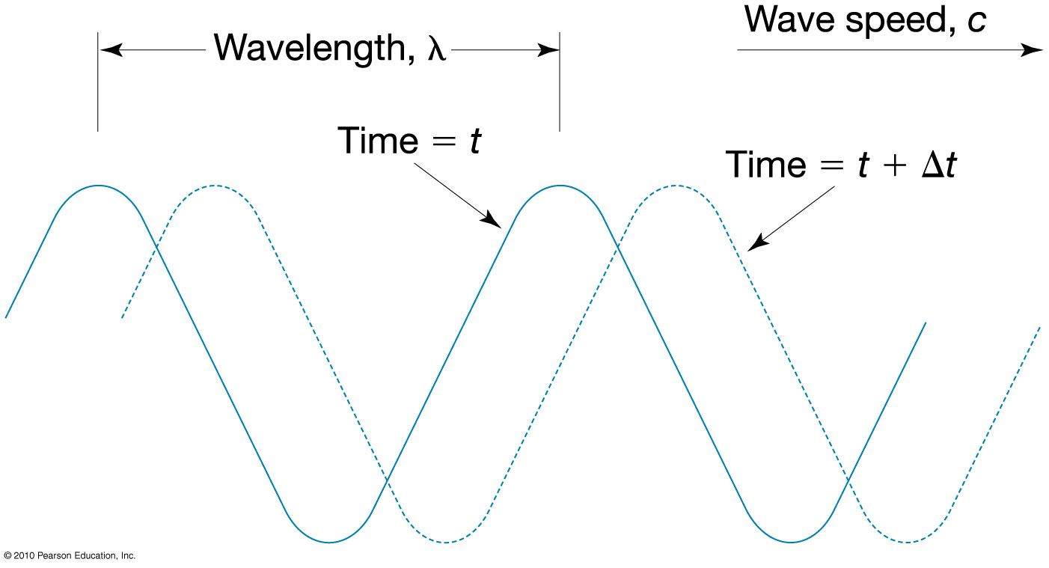
Key concept 1-Some fundamentals of electromagnetic radiation
Linked electric and magnetic disturbances.

Slide 4
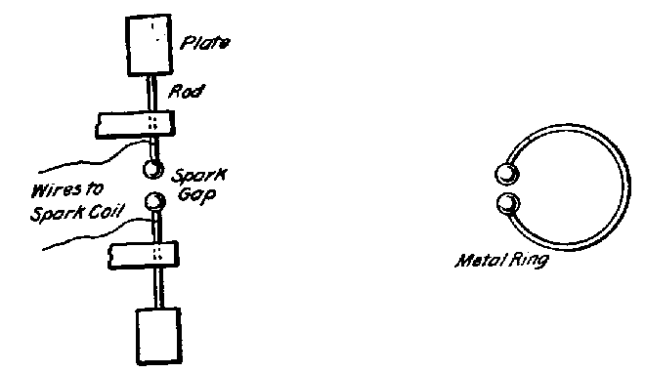
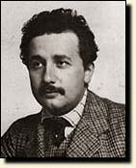
Hertz’s experiment-discovery of the photoelectric effect
Key points: l
Light carries energy
This energy is in packages (photons)
Energy of a single package depends on the wavelength.
Ability to generate spark found to depend on the metal… and the frequency of the light.

Slide 5
Electromagnetic radiation
Consists of linked electric and magnetic disturbances propagating through space.
Wavelike behavior (scattering, refraction, Doppler shifting). Governed by wavelength.
Particle-like behavior- photons.
Energy is quantized.
Means that the amplitude of wave is fixed for given wavelength. $E \left(ev\right)=1.23/λ(microns)$
When photons are absorbed and re-emitted they behave like particles.

Slide 6
Types of radiation
rst.gsfc.nasa.gov

Slide 7
Black body radiation- objects radiate according to temperature
Everything in the universe radiates.
It does so by emitting some combination of wavelengths “colors”.
Wien’s law: Energy of peak wavelength
$$λ=2900 \frac{μm∗K}{T}$$
climatemodels.uchicago.edu/modtran

Slide 8
What is the temperature at the surface of the sun?
$$λ=2900 \frac{μm∗K}{T}$$
0.38 0.45 0.495 0.57 0.59 0.62 0.75
Wavelength in micrometers (upper value is in nm)

Slide 9
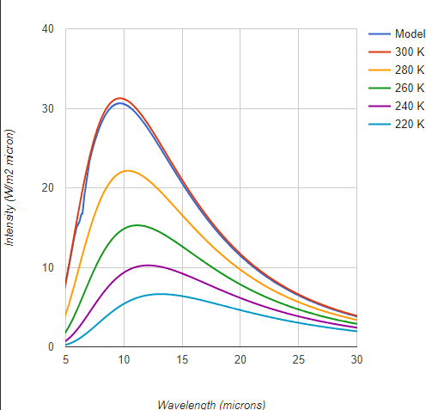
Blackbody spectra
The total amount of radiation emitted is determined by the temperature in K.
$$Q=σT^{4}=5.67×\frac{{10}^{−8 }W}{m^{2}K^{4}}T^{4}$$

Slide 10
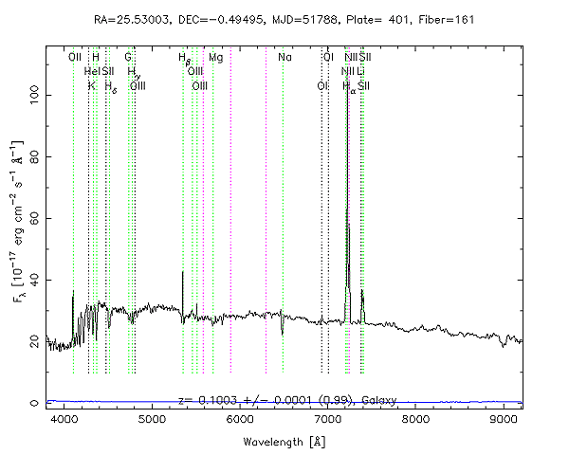
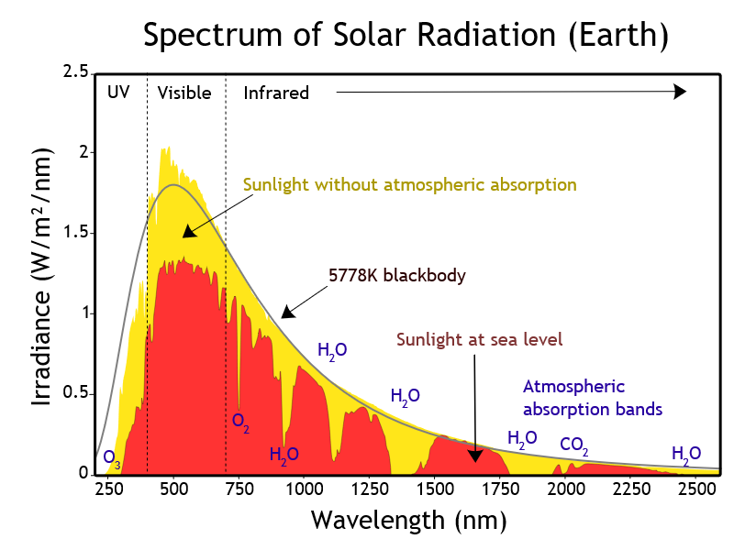
Actual radiation spectrum deviates from black body
Emission lines associated with particular elements raise temperatures above background
Absorption by specific chemicals reduces penetration.
By Nick84 - File:Solar_spectrum_ita.svg, CC BY-SA 3.0, https://commons.wikimedia.org/w/index.php?curid=24648395

Slide 11
Implication
If you know the color of an object- you know how much energy it is radiating per unit area.
If you know the distance and the brightness this tells you how big the star is.
How do we tell distances?

Slide 12
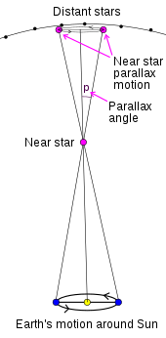
Close in- Sirius
Stellar parallax
Standard unit is 1 second (1/60/60 of 1 degree)
Equal to 3.26 light years
With Hubble we can measure up to 10,000 light years

Slide 13
H-R diagram
Plots luminosity (relative to sun here) vs.
Color
“Main sequence” marks where stars start out (burning hydrogen)
Stars off main sequence tend to be later in life.

Slide 14
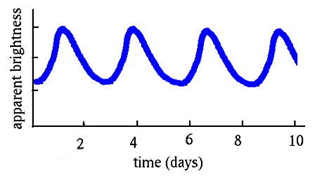
“Standard candles”
Cepheid variables- stars whose period of variability is related to their luminosity
Type 1-A Supernovae (stars collapse)

Slide 15
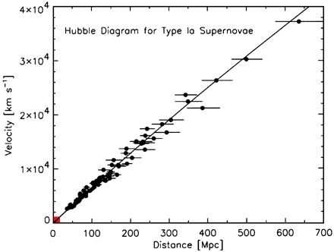
Hubble law
Far away galaxies have emissions lines whose location is shifted.
If line is shifted by 1% of its wavelength….
Speed is 1% of speed of light
Check out http://cas.sdss.org/dr3/en/proj/advanced/hubble/simple.asp
To go through an exercise about this.

Slide 16
Interesting sidenote…
Hubble constant estimates from two recent missions are different by more than the experimental error on the two missions…..
(Hubble tension)
By Primefac - Own work, CC BY-SA 3.0, https://commons.wikimedia.org/w/index.php?curid=32089452

